Slide 1
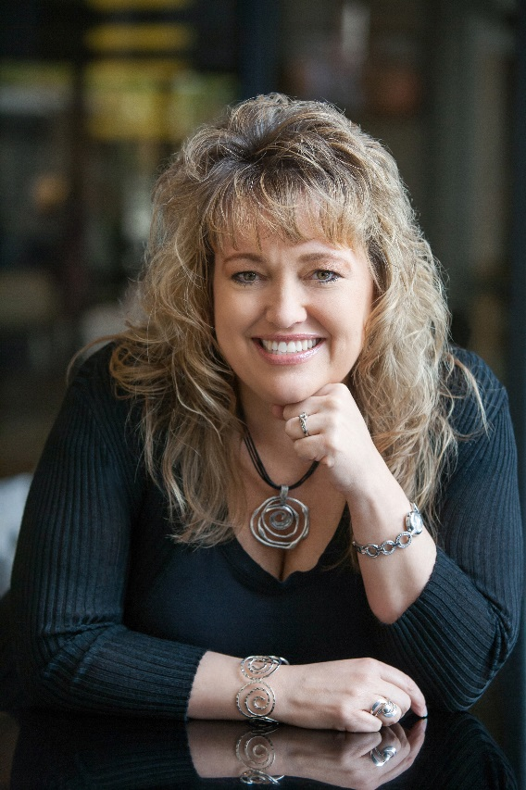
“Love Yourself to Success & Excellence”
With Katrina Sawa
The JumpStart Your Biz Coach
Speaker & Author
www.JumpStartYourMarketing.com
www.LoveYourselfSuccessful.com

Slide 2
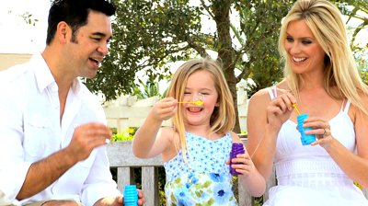
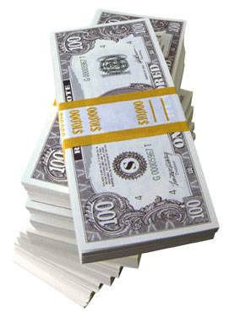
Do You Have the Life You Truly Desire Now?
If not... What’s Missing?
Notes:
You’re overwhelmed or tired of working so hard
You’re trying to figure out the least expensive, most effective ways to market your biz and make money
You need help navigating the world of online marketing and technology
You want to develop a business you’re passionate about but also one that makes you money and you aren’t sure how to do that
Figure out how to get more of the right things done every month to bring in more clients and make more money easier
Figure out which programs and offerings can help you leverage more in your biz
Get new ideas to implement
As a speaker and a business owner, when we got into business, we had dreams of:
Flexible schedules - More time with family - More money and freedom - More balance and less stress
Yet what we got was:
Longer hours - Big investments – Overwhelm - Huge to do lists
So, how can you transform your business into a smoother running, passion-driven, freedom-based and moneymaking business? You can decide to change it up. Add new business models, leverage your time and expertise into programs and services that not only that you love to deliver but others receive so much value from. Get out of the overwhelm you’re in either with too much to do currently in your business or too many ideas and no time to implement them all. Instead find a way to simplify what you’re selling in your business in order to serve more of your ideal clients at the highest level. Create and enjoy your business fully when you can serve at the highest level and transform more lives faster with your gifts.

Slide 3
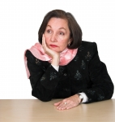
Are You Doing What You Love?
OR
If not, what are you tolerating?
Notes:
No, this isn't a magic pill approach or concept; it's plain and simple, proven business-building strategies that are guaranteed to give you a better quality of life – doing what you love to do! Would you like to know EXACTLY what to do, how to do it, where to spend your time or money, how create, build and market a business so you can start earning income for yourself and making your own hours today? I realize that this may be NEW INFORMATION to you….that you CAN indeed have your own business. I’m not trying to say its super easy, its not. But its also not as scary or hard as you may think. You just need to know what you don’t know is available to you or what’s out there or maybe brainstorm some ideas with someone who thinks differently than you.This can happen much sooner than you realize - Don’t WAIT to start your own business if that’s really something you want to do, do it now. NOW, when you are NOT in the perfect JOB or maybe you’re unemployed and searching….NOW is the perfect time to launch a new business. Why? Because you have the TIME it will take to devote to getting started. When you have a JOB, there is little to no time left to do this and it could take you years to get a business up and running making money. Do it now while you have the time to FOCUS and TAKE ACTION.

Slide 4
Are You Making the Money You Want?
If not, how much do you want?
Notes:
No, this isn't a magic pill approach or concept; it's plain and simple, proven business-building strategies that are guaranteed to give you a better quality of life – doing what you love to do! Would you like to know EXACTLY what to do, how to do it, where to spend your time or money, how create, build and market a business so you can start earning income for yourself and making your own hours today? I realize that this may be NEW INFORMATION to you….that you CAN indeed have your own business. I’m not trying to say its super easy, its not. But its also not as scary or hard as you may think. You just need to know what you don’t know is available to you or what’s out there or maybe brainstorm some ideas with someone who thinks differently than you.This can happen much sooner than you realize - Don’t WAIT to start your own business if that’s really something you want to do, do it now. NOW, when you are NOT in the perfect JOB or maybe you’re unemployed and searching….NOW is the perfect time to launch a new business. Why? Because you have the TIME it will take to devote to getting started. When you have a JOB, there is little to no time left to do this and it could take you years to get a business up and running making money. Do it now while you have the time to FOCUS and TAKE ACTION.

Slide 5
Notes:
Not including the money of course, we’re going to fix that tomorrow.
Take a few minutes to write out areas that you aren’t completely happy with, what you’d like to see change or be different, what’s missing for you?
Ask if anyone wants to share?
5

Slide 6
Notes:
Not including the money of course, we’re going to fix that tomorrow.
Take a few minutes to write out areas that you aren’t completely happy with, what you’d like to see change or be different, what’s missing for you?
Ask if anyone wants to share?
6

Slide 7
Why I’m Here...
+
=
+
=
Notes:
You’re overwhelmed or tired of working so hard
You’re trying to figure out the least expensive, most effective ways to market your biz and make money
You need help navigating the world of online marketing and technology
You want to develop a business you’re passionate about but also one that makes you money and you aren’t sure how to do that
Figure out how to get more of the right things done every month to bring in more clients and make more money easier
Figure out which programs and offerings can help you leverage more in your biz
Get new ideas to implement
As a speaker and a business owner, when we got into business, we had dreams of:
Flexible schedules - More time with family - More money and freedom - More balance and less stress
Yet what we got was:
Longer hours - Big investments – Overwhelm - Huge to do lists
So, how can you transform your business into a smoother running, passion-driven, freedom-based and moneymaking business? You can decide to change it up. Add new business models, leverage your time and expertise into programs and services that not only that you love to deliver but others receive so much value from. Get out of the overwhelm you’re in either with too much to do currently in your business or too many ideas and no time to implement them all. Instead find a way to simplify what you’re selling in your business in order to serve more of your ideal clients at the highest level. Create and enjoy your business fully when you can serve at the highest level and transform more lives faster with your gifts.

Slide 8
Today’s Presentation Is About:
Discovering What You Really Want
Increasing Your Confidence & Clarity
Learning How LOVE Affects You Making Money
How to Create or Redesign YOUR Big Money Generating Biz/Career & Love-Filled Life

Slide 9
Define Your Vision What’s Your Big WHY?
Notes:
Your bigger why goes beyond your annual money needs, your passions….it’s about something bigger than that.
Who can tell me what they believe their bigger why is for doing what they’re doing?
9

Slide 10
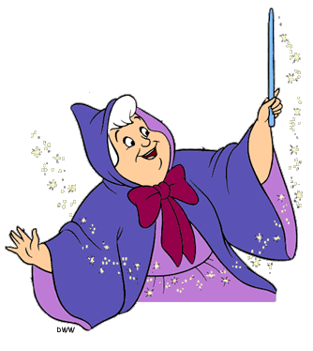
Where Do You Want to Be?
Notes:
Then you have to truly see what else is possible to where you can go
So many people I meet and work with privately have no idea the magnitude that they are destined to be
Or have no idea just how big and how much money their business can be
They just don’t ‘see’ it yet but I do….
10

Slide 12
Notes:
Where are your blocks?
Take a moment and think about where you’re stopping yourself?
Write it down….
12

Slide 13
#1 Saboteur = Our Mindset
1. Money mindset issues:
How to charge what you're worth
How to ask for the sale/raise
You deserve to make money
You have to work harder to make more
2. Beliefs about ourselves:
I don’t deserve it
Who am I to do that
I’m not good enough
Fill in the blank with your HEADTRASH
Notes:
Tell my story of leaping from coach to coach along my journey
How I don’t expect you all to coach with me forever, hopefully you get what you need in just the right time, then move on your next mentor
You never want to pick a mentor who thinks they are the ONLY solution for you
I believe there are many people who can help you and I refer clients to other professionals all the time as they take new steps in their journey
I’m here to accelerate your growth in self, income and to jumpstart your business systems, markeitng and sales
13

Slide 14
A Few Things to Think About in Regards to LOVE:
Are you completely and totally happy personally?
What’s missing in your personal life?
Is your love relationship 100% supportive?
Do you need or want a love relationship?
Are you settling?
Are you good to yourself?
Are you valuing yourself?
What are you tolerating?

Slide 15
A Few Things to Think About in Regards to MONEY:
When is the last time you raised your rates/asked 4 raise?
Are you selling/offering the right things?
Have you been avoiding changing/investing in your website?
Are you productive & doing enough day-to-day RPA's (revenue producing activities – lead generation, marketing & follow up)?
Have you invested in a mentor / mastermind?
What can you automate, delegate and systematize?

Slide 16
Let’s Check in and See Where You Are With Both – LOVE & MONEY

Slide 17
“Life is a Highway”

Slide 18
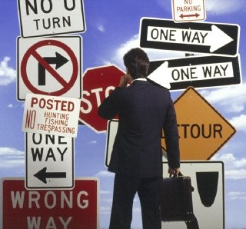
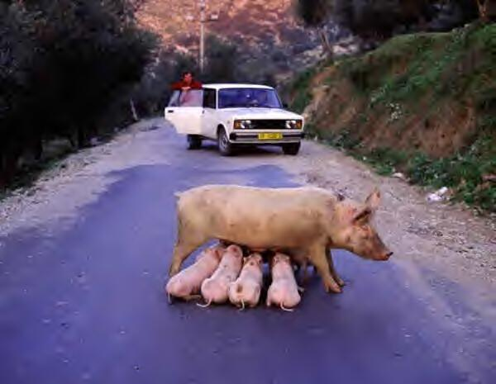
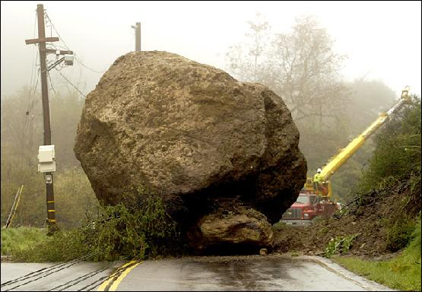
Expect Roadblocks

Slide 19
Share Your Biggest Roadblock…
Notes:
Write on white board what people say
To bring out the biggest objections people will have to MM
Mindset or beliefs to getting what you want? Love or money?

Slide 20
Notes:
Write on white board what people say
To bring out the biggest objections people will have to MM
Mindset or beliefs to getting what you want? Love or money?

Slide 21
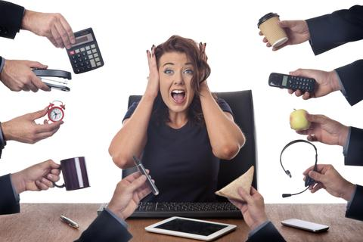
My Story….

Slide 22
My Journey… Not Always So Easy!
I used to be where many of you are today:
In a job I hated
In unsupportive marriage
Quit my job to start something on my own
Wasted money and time with the wrong things/people
Trading hour for dollar at first, thinking I could only charge so much
Working way too hard and too many hours, burned out
Not having balance in my life
Thinking that “I’m smart, I can figure it out on my own”
I had NO idea I could do what I’m doing now!

Slide 23
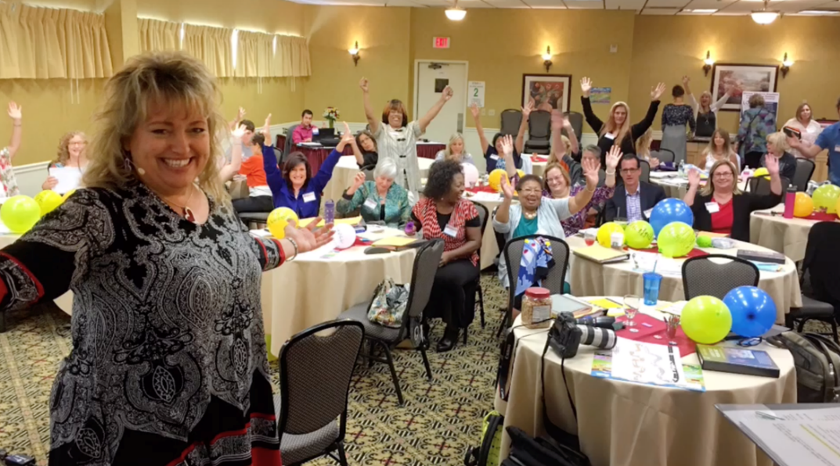
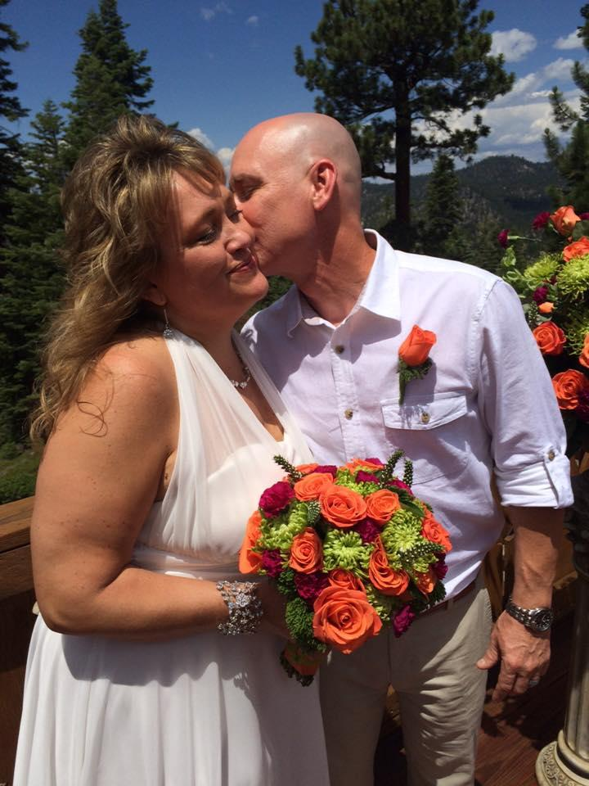
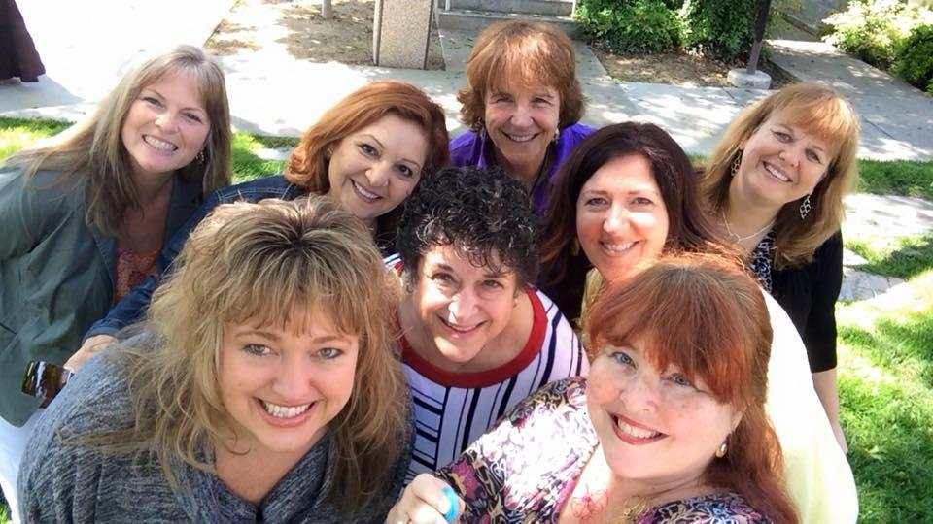
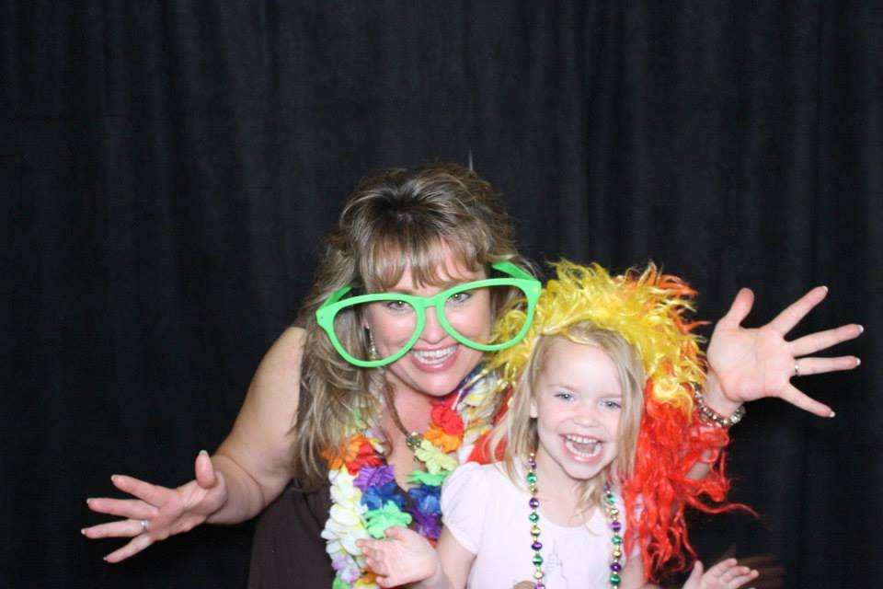
To this….

Slide 24
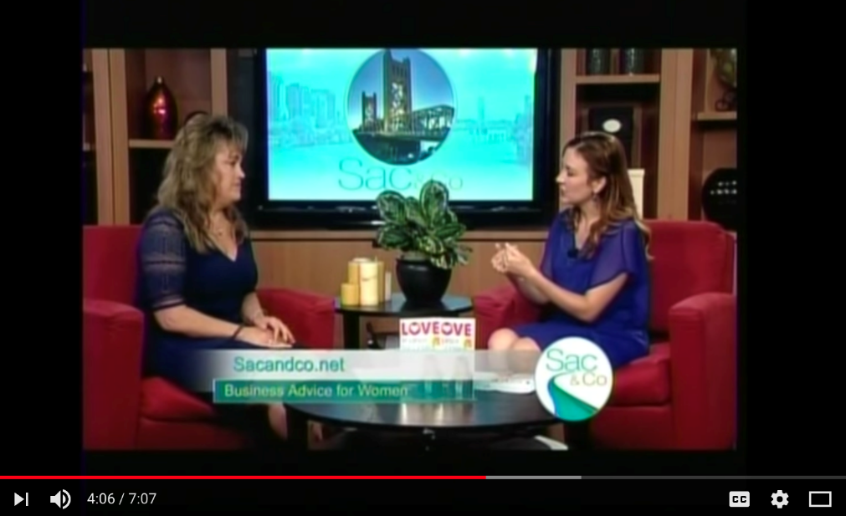
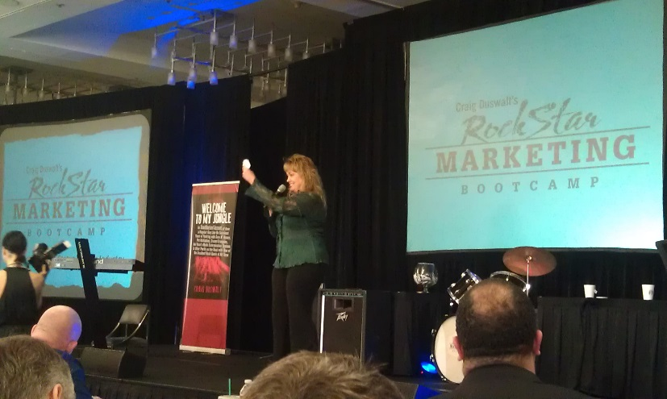
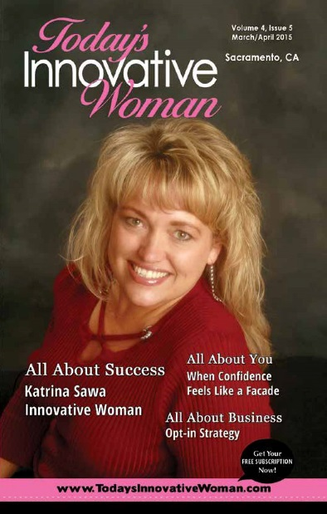
What I’ve Accomplished Thus Far...
60+ speaking gigs/year
Sold $100K multiple times @ weekend events
Reg TV Expert
Awards for business & collaboration
Best Selling Author
Consistent 6+Figures since 2008
Notes:
This is a little outdated, some old pricing

Slide 25
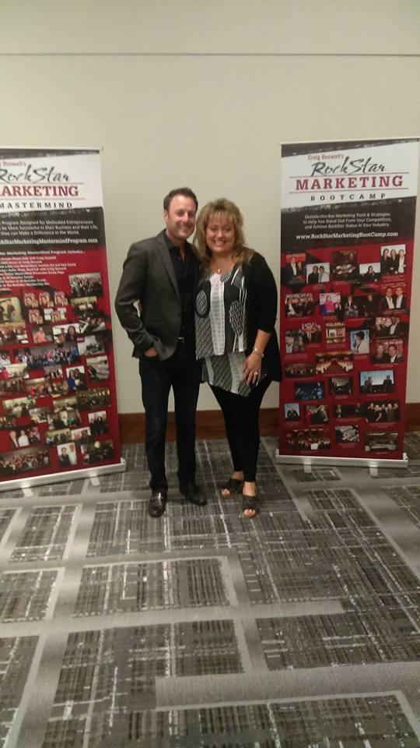
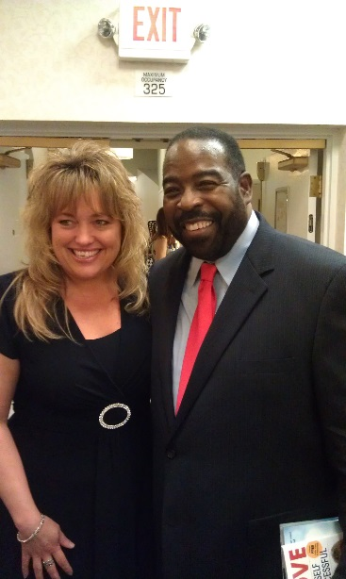
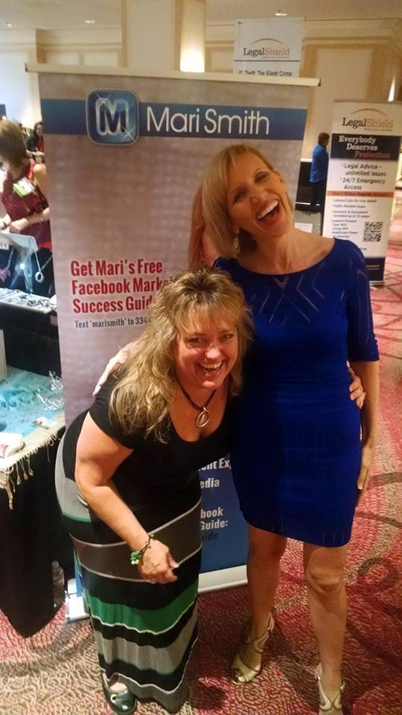
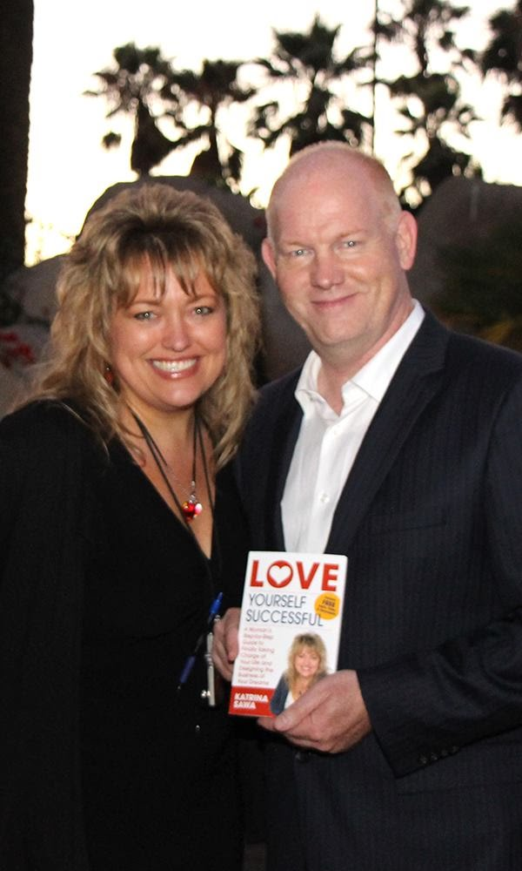
PLUS, I get to hang out with some really cool people!
Notes:
This is a little outdated, some old pricing

Slide 26
Yes… there were a few Roadblocks

Slide 27
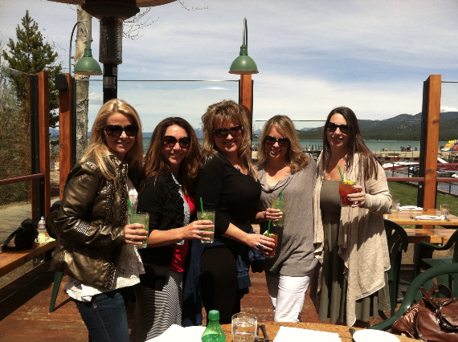
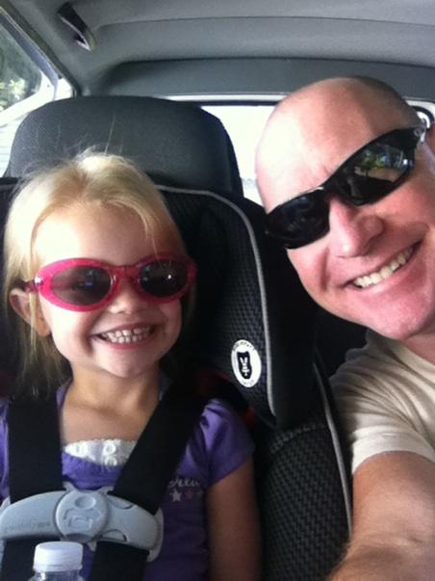
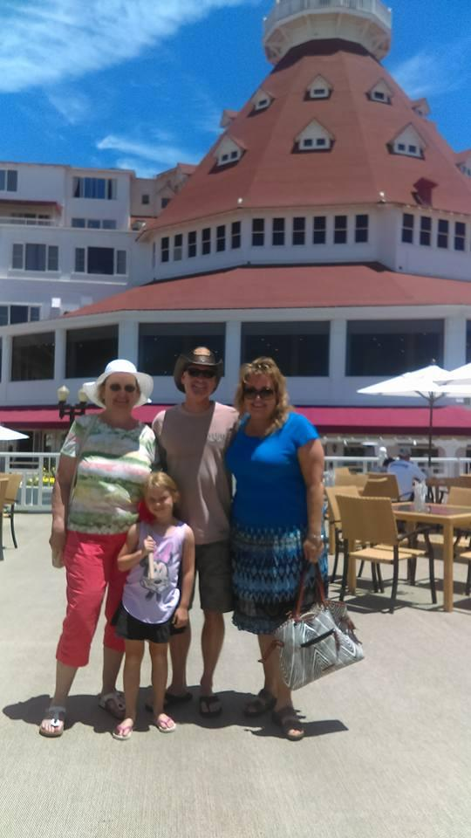
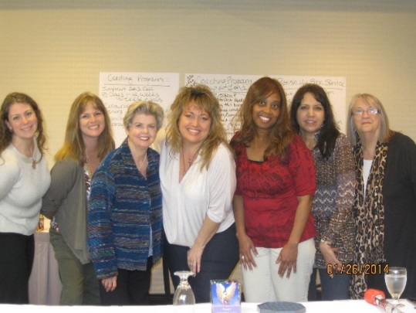
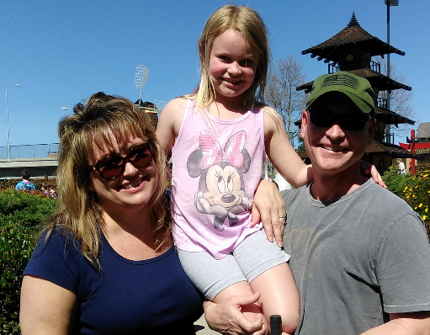
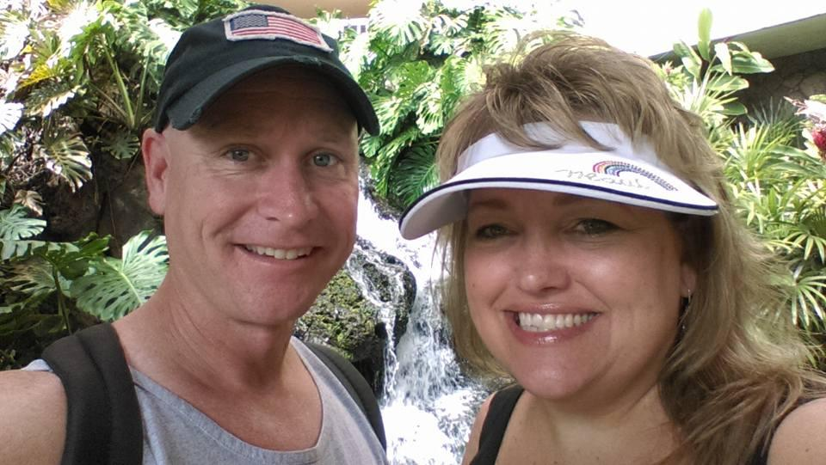
Design the Life YOU Want!

Slide 28
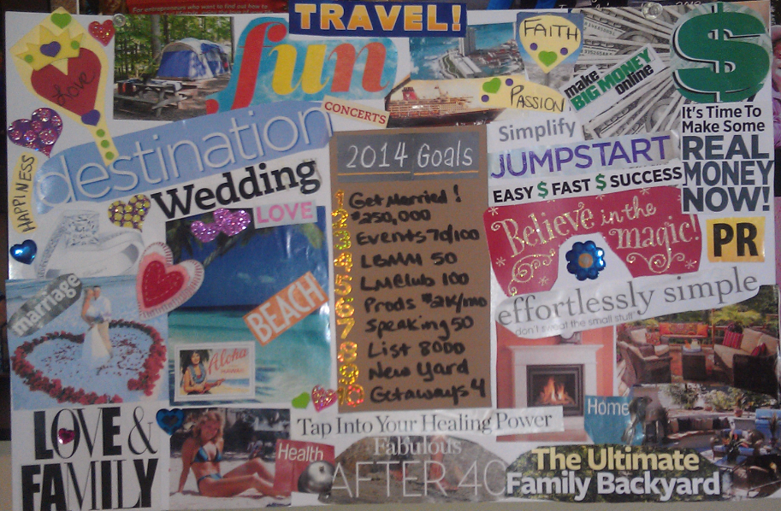
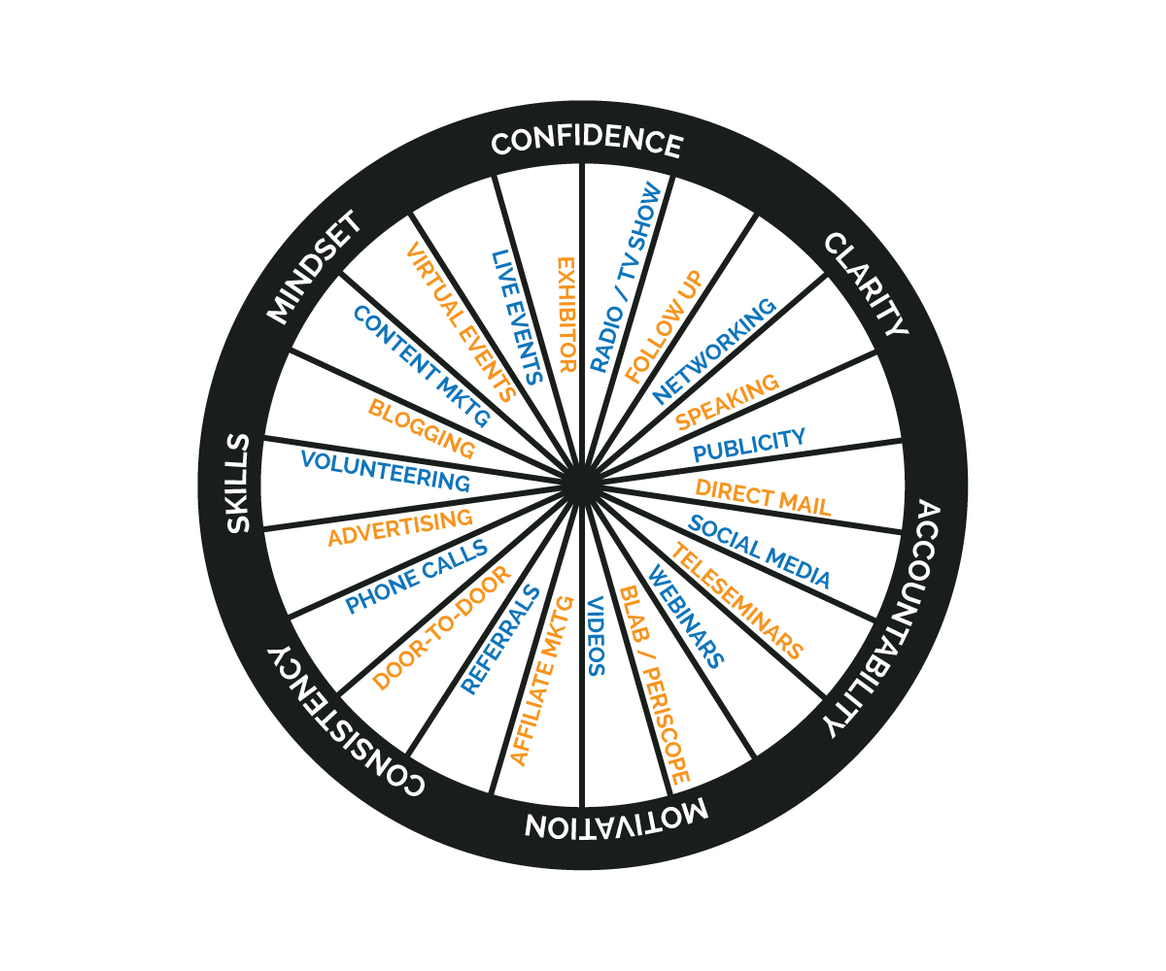
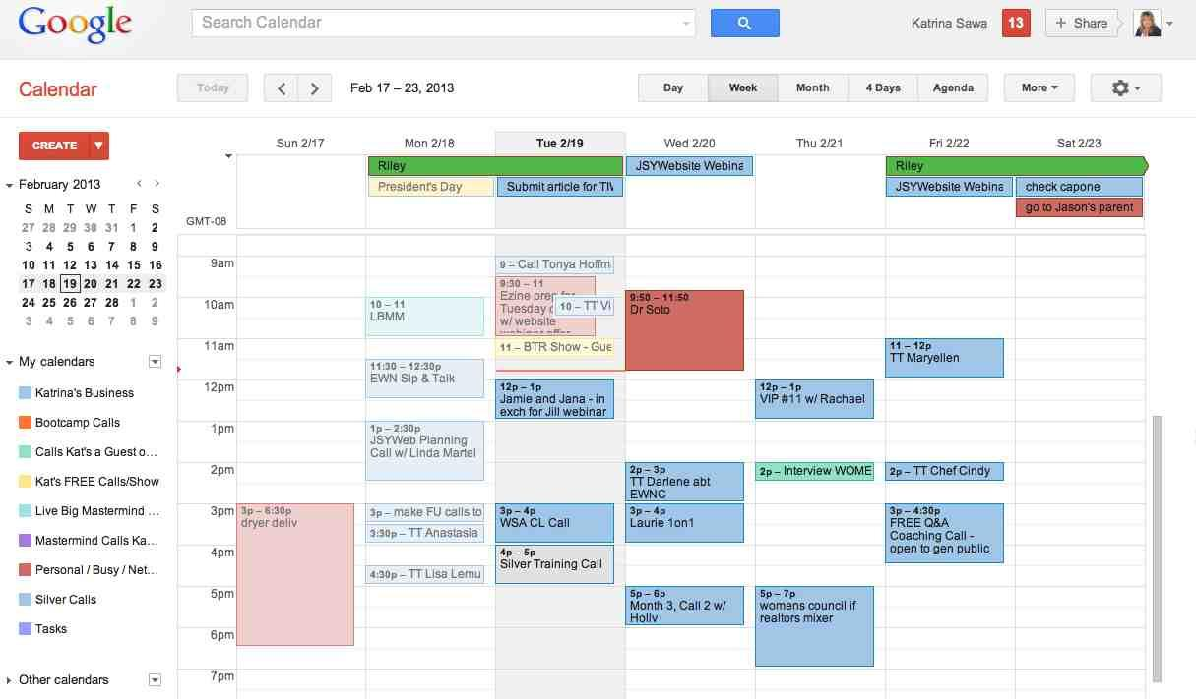
How Did I Do This?

Slide 29
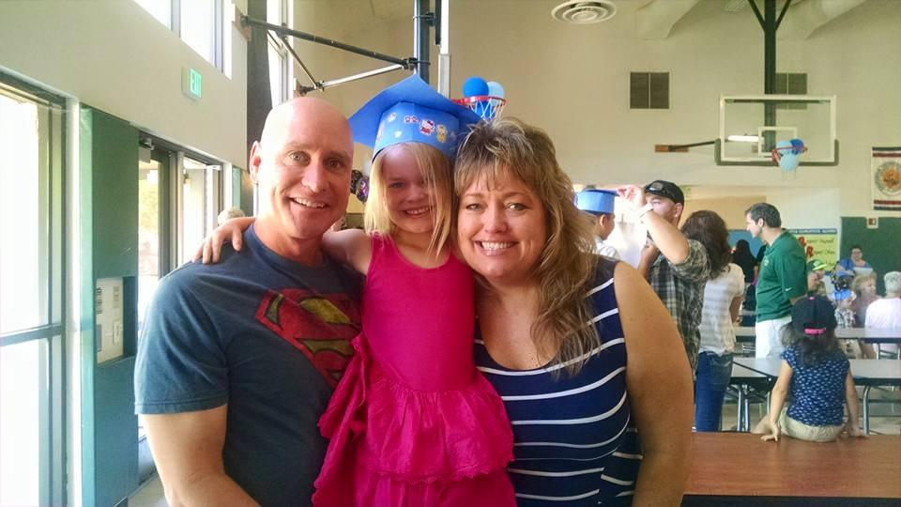
Why Learn From Me?
I know what matters most and won’t let you lose sight of that!
Love & Money are the Keys

Slide 30
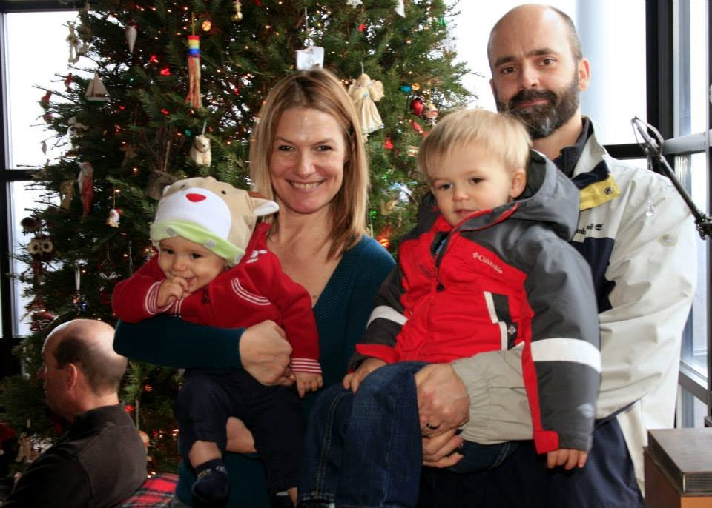
Miranda Mathewson
~ Miranda Mathewson (used to be Zukowski), Fitness Expert & Trainer, New Jersey, www.MirzukFitness.com
Notes:
Crying self to sleep story

Slide 31
What You Must Do to Succeed FASTER In Business Today…
Express an undying PASSION for your work
Possess the ability to GET PAID (a lot)
LEVERAGE everything you can
Study with a Mentor that is where you want to BE & who will make you PLAY BIGGER (to speed up the process) and hold you accountable!
Notes:
Tell my story of leaping from coach to coach along my journey
How I don’t expect you all to coach with me forever, hopefully you get what you need in just the right time, then move on your next mentor
You never want to pick a mentor who thinks they are the ONLY solution for you
I believe there are many people who can help you and I refer clients to other professionals all the time as they take new steps in their journey
I’m here to accelerate your growth in self, income and to jumpstart your business systems, markeitng and sales

Slide 32
Let’s Talk About Love…

Slide 33
The “Love Factor” WILL Affect Your Business/Career… Just How BAD Is the Question?
Notes:
How you feel and are treated in your personal life reflects how you project yourself in your business life, it’s that simple.
Let me explain what I’m talking about when I say love…

Slide 34
The 4 Types of Love…According to My Book

Slide 35
Self Care Self Worth Boundaries Daily Routine Inspiration Must Haves Dreams
1. Love for Self

Slide 36
The 4 Types of Love…According to My Book
2. Love For What You Do

Slide 37
The 4 Types of Love…According to My Book
3. A Love Filled Environment

Slide 38
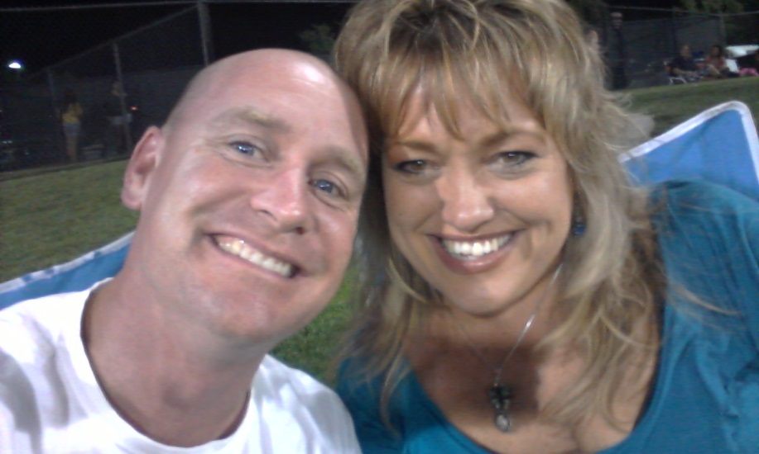
The 4 Types of Love…According to My Book
4. Your Love Relationship

Slide 39
So, What’s Happening With You in the Love Department? What Do You Want to See Change for You?
Notes:
Pair share – 3 min total
Think about it and on Friday when we plot your action steps out we’re going to be including some action steps for your ‘love factor’ too

Slide 40
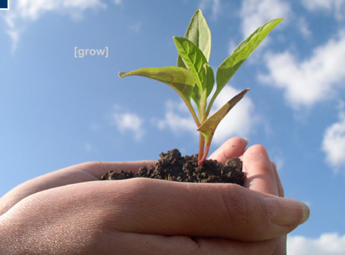
“Anything you give energy to, grows” ~ David Neagle

Slide 41
Share One Thing You’d Like to See Change In Your Personal Life
Notes:
Write on white board what people say
To bring out the biggest objections people will have to MM
Mindset or beliefs to getting what you want? Love or money?

Slide 42
Your Top 3 Action Steps:
Goal setting –
Big picture what do you want to accomplish?
What do you want to create, develop or launch?
How much money do you want to bring in?
Number of clients, attendees, etc.?
What to change personally?
What to change professionally?
Your To Do List
Big Knarly List broken down by project or type of task possibly
Daily checklist for action steps
What to delegate
What do you PERSONALLY NEED TO WORK ON TOO?

Slide 43
How Will You Change Your Environment?
Redesign your business model/structures
Build a team
Delegate more
Surround yourself with support and love
Plan out your marketing
Hire a coach &/or get into a mastermind

Slide 44
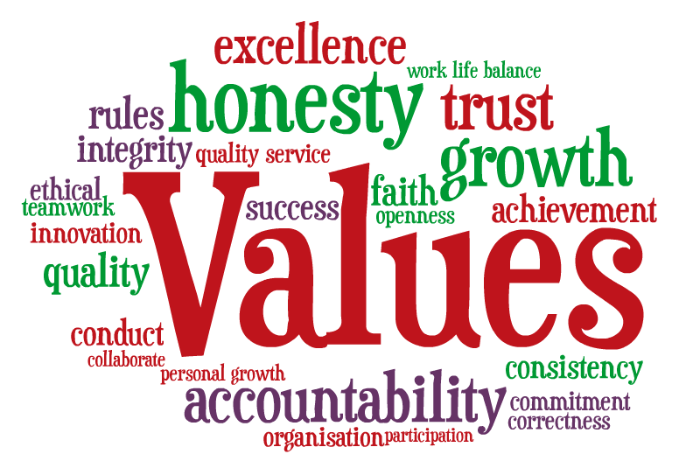
Notes:
But first, I want to make sure there aren’t any
Questions and I would like to see if anyone wanted to share from yesterday???

Slide 45
Share Your Top 1-3 To Do’s or Takeaways…
Notes:
Write on white board what people say
To bring out the biggest objections people will have to MM
Mindset or beliefs to getting what you want? Love or money?

Slide 46
Recap:
Discovering What You Really Want
Increasing Your Confidence & Clarity
Learning How LOVE Affects You Making Money
How to Create or Redesign YOUR Big Money Generating Biz/Career & Love-Filled Life

Slide 47
RESOURCES:
FREE Audios & Trainings on:
Love Yourself Successful
Jumpstarting Your Business
Speaking & Getting Speaking Gigs
Developing Ideas or Your Purpose
Hiring & Delegating to a Team
Updating & Monetizing Your Website
And more!
www.JumpstartYourMarketing.com/Toastmasters

Slide 48
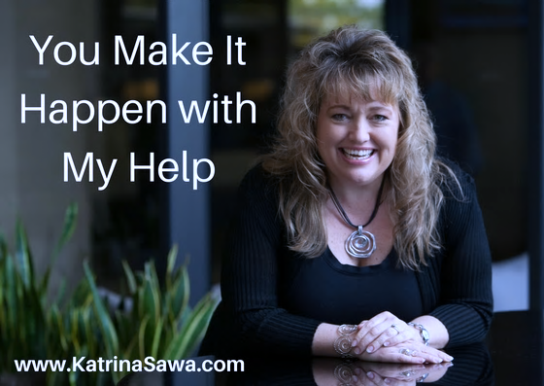
Notes:
This is a little outdated, some old pricing

Slide 49
Want the Fast Track to Implementation?
Notes:
Implementatoin is the bridge between where you are and where you want to be
It will depend on how FAST you want to get there on what choices and decisions you make along the way…
Obviously I took the fast track, hiring mentors, coaches, attending lots of workshops, being a part of a mastermind group for 3 years in a row when I first changed my business model
I wanted to learn from someone who’s been there, done that, made the mistakes and could tell me what NOT to do just as much as what TO do
This year was the only year I wasn’t in a mastermind group since I was planning this event and while there may not be that many people here, it’s still a huge leap to my next level
However this year I did hire coaches for spot coaching and am also a part of a mastermind – pretty high end and high investment.

Slide 50
Invest in YOU NOW and FINALLY Get a JumpStart on Your Business & your Life over the next year!

Slide 51
THE TIME IS NOW!
Notes:
Tell my story of leaping from coach to coach along my journey
How I don’t expect you all to coach with me forever, hopefully you get what you need in just the right time, then move on your next mentor
You never want to pick a mentor who thinks they are the ONLY solution for you
I believe there are many people who can help you and I refer clients to other professionals all the time as they take new steps in their journey
I’m here to accelerate your growth in self, income and to jumpstart your business systems, markeitng and sales
51

Slide 52
Mentors Give You…
Confidence
Clarity
Constant Correction
Contacts
Friends see your present…
Mentors see your FUTURE!

Slide 53
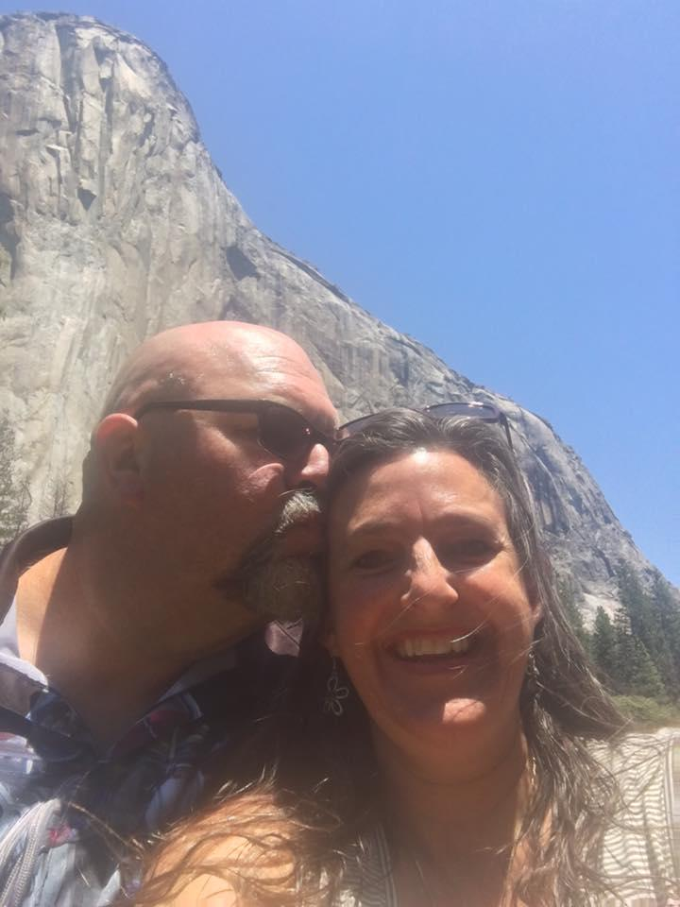
Darla was just able to finally take a paycheck from her non-profit last year!
“I doubled my income in my business in the first 8 months!”

Slide 54
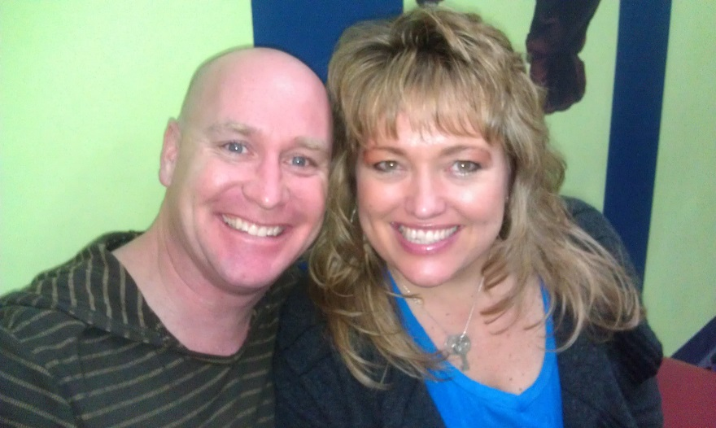
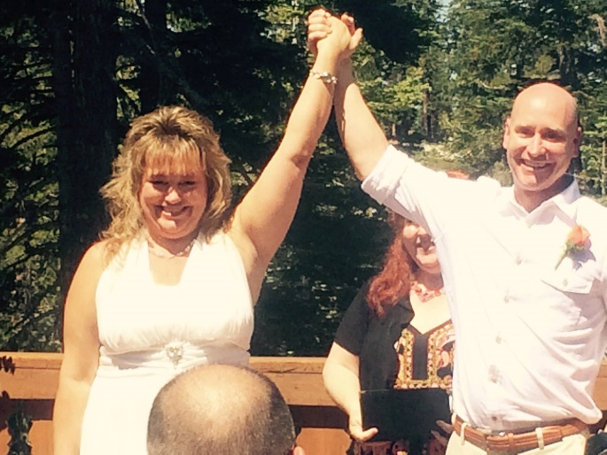
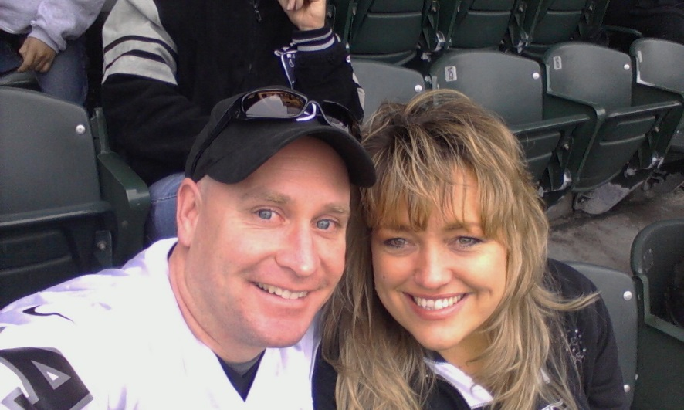
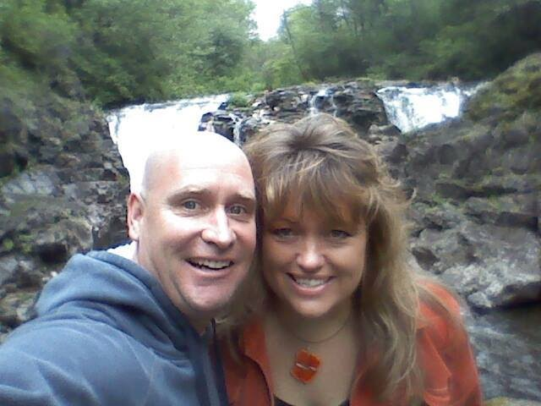
This is my “What IF”, What’s Yours?

Slide 55
Join Me One Way or Another Today!
Let Me Get My Hands On You to Jumpstart Your Business!

Slide 56
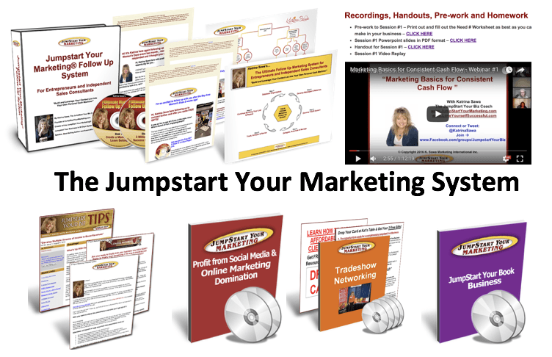
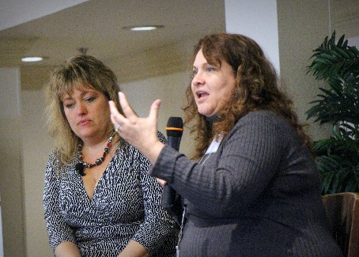
The Jumpstart Your Life & Business Package

Slide 57
Includes: The Jumpstart Your Marketing System

Slide 58
Bonus #1: $1,797 Value (2 Tickets)
You’ll learn WHAT to do and HOW to do it to …
Make a LOT More Money Doing What You Love,
While Getting Out of Overwhelm!

Slide 59
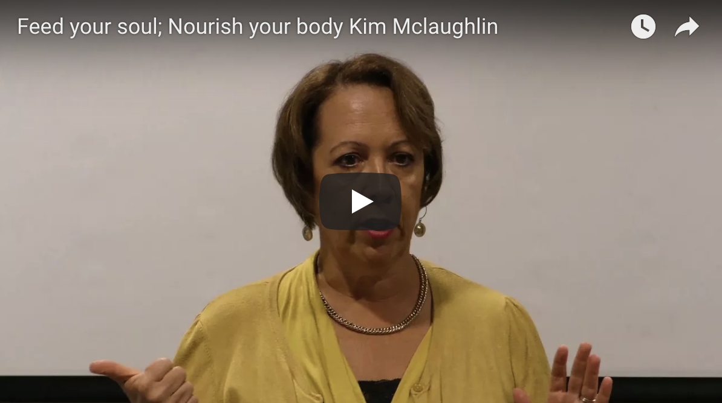
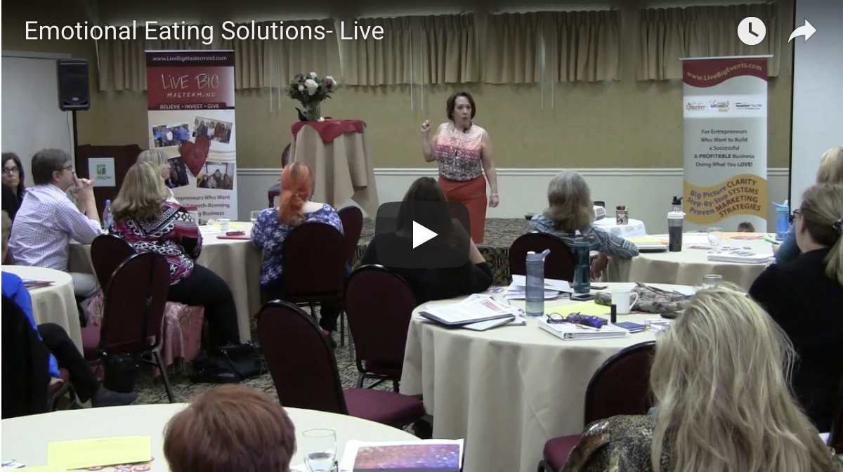
Speaker Success Bootcamp June 14, 15, 16, 2018
Notes:
Talk briefly about product and show order forms

Slide 60
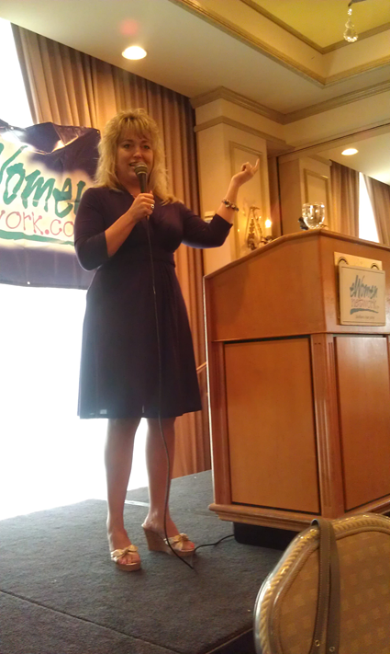
Kat’s 6 Step Jumpstart Yourself as a Dynamic Speaker System
What are you selling / expert in?
Developing your talk outlines & info
How to get yourself booked
Creating your presentations
Back of the room set up and strategy
Lead capture, follow up and sales plan
Notes:
Talk briefly about product and show order forms

Slide 61
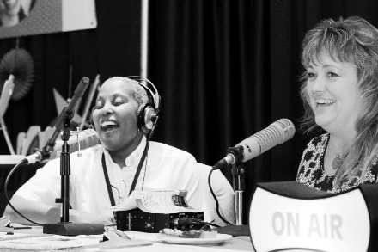
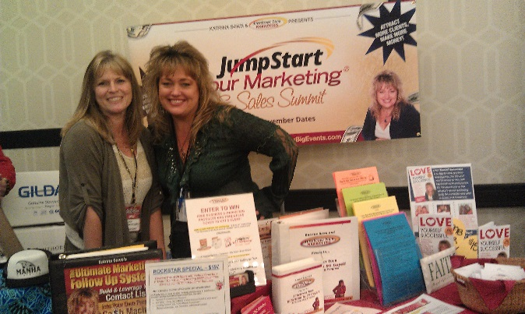
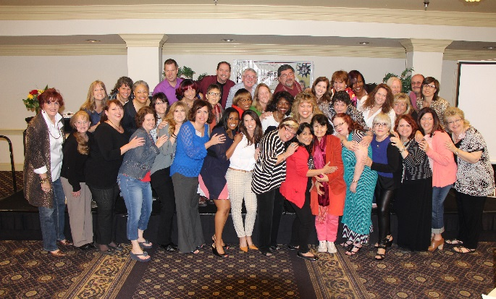
“95% of My Income Comes from Speaking, Networking or Hosting My Live Events”
$60-120K/event
$7-20K/gig

Slide 62
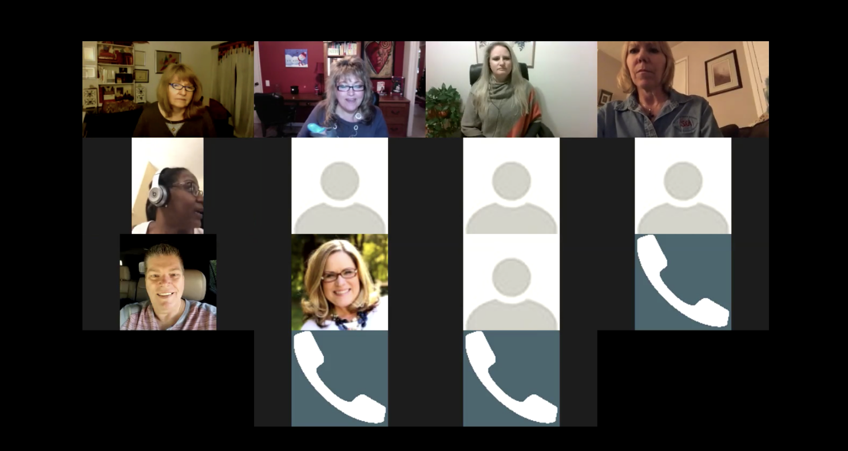
Bonus #2: Over $1000 Value!
2 - 2 Hour LIVE Masterclasses!
Where we’re going to help you figure out how to maximize and monetize your biz and life!

Slide 63
Bonus #3: My Book!

Slide 64
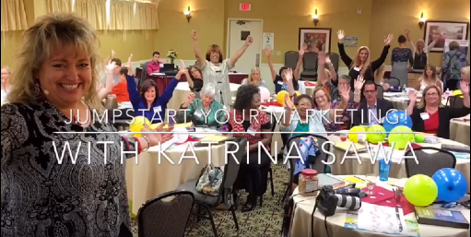
Let Me Help You Transform Your Life & Business, Making a Bigger Impact with More Love & Money too!
$997
+ 3 Bonuses:
Bonus #1: 2 Tickets to Any 2018 Event Value $1797
Bonus #2: 2 -2 Hour LIVE Masterclasses Value $1000
Bonus #3: Kat’s Book Value $17
Total Value Over $3,300

Slide 65
Jumpstart Your Life & Business Package
Today Only $197!
First 5 People Get a BONUS 1 Hour Business Planning Session 1on1 with Katrina!

Slide 66
RESOURCES:
FREE Audios & Trainings on:
Love Yourself Successful
Jumpstarting Your Business
Speaking & Getting Speaking Gigs
Developing Ideas or Your Purpose
Hiring & Delegating to a Team
Updating & Monetizing Your Website
And more!
www.JumpstartYourMarketing.com/Toastmasters

